Slide 1
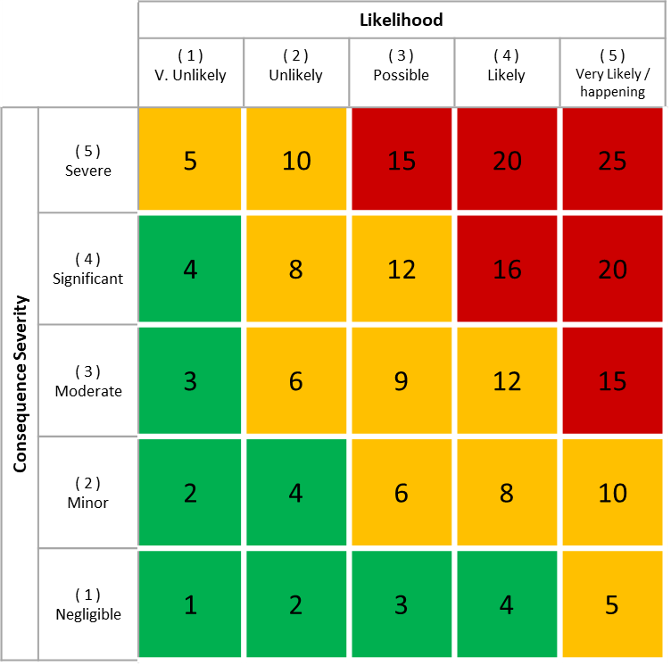
Risk Management Dashboard Case Study

Slide 2
Background
There have been several critical equipment failures
These failure resulted in high levels of downtime.
Increased visibility of risks would have helped identify and prevent these failures.
Recommended that a defect risk management process and accompanying tool is created.

Slide 3
Requirements Summary
Display a high level risk status resulting from equipment defects at the site.
Provide an overview of the risk matrix with the number of defects in each risk ranking.
Provide a risk matrix with the ability to view the work orders related to the repair of each defect in each risk ranking.
Provide analysis of pre and post mitigation risk.
Provide a trend of the number defects at the site over time, split by risk grouping.

Slide 4
The 5 Steps to Building an Effective Dashboard
1. Define
2. Model
3. Build
4. Implement
5. Evolve

Slide 5
1. Define - Requirements of Risk Management Report
Requirements | Role
Display a high level risk status resulting from equipment defects at the site. Provide an update on the status of repairs for high risk defects. Provide an overview of the risk matrix with the number of defects in each risk ranking. This information will be viewed on a large screen in the office and at the site. It will also be viewed on a mobile devices. | Plant manager and other senior managers and stakeholders.

Slide 6
1. Define - Requirements of Risk Management Report
Requirements | Role
Provide a risk matrix with the ability to view the work orders related to the repair of each defect in each risk ranking. Allow filtering by department. | Operations manager and department leads.
Provide analysis of pre and post mitigation risk. Provide a trend of the number defects at the site over time, split by risk grouping. | Asset manager, operations manager.

Slide 7
2. Model - Data
The data has been exported from the CMMS to an Excel. It will be manually updated each week.
The each row represents a work order in the CMMS to repair a reported defect.
A snapshot of all the live defects has been captured at the start of each week to allow a trend of the number of live defects to be created.

Slide 8
2. Model - Risk Matrix
 |  | Likelihood
 |  | ( 1 ) V. Unlikely | ( 2 ) Unlikely | ( 3 ) Possible | ( 4 ) Likely | ( 5 ) Very Likely / happening
Consequence Severity | ( 5 ) Severe | 5 | 10 | 15 | 20 | 25
 | ( 4 ) Significant | 4 | 8 | 12 | 16 | 20
 | ( 3 ) Moderate | 3 | 6 | 9 | 12 | 15
 | ( 2 ) Minor | 2 | 4 | 6 | 8 | 10
 | ( 1 ) Negligible | 1 | 2 | 3 | 4 | 5
When a work order created to report a defective item of equipment it is allocated a risk assessment number using the following risk matrix.
Step 1: A credible scenario is agreed as a possible outcome as a result of the equipment defect.
Step 2: The potential impact on the business is agreed among the risk assessment team. This provides the consequence severity number on the y-axis of the matrix.
Step 3: The likelihood of that outcome is agreed among the risk assessment team. This provides the likelihood number on the y-axis of the matrix.

Slide 9
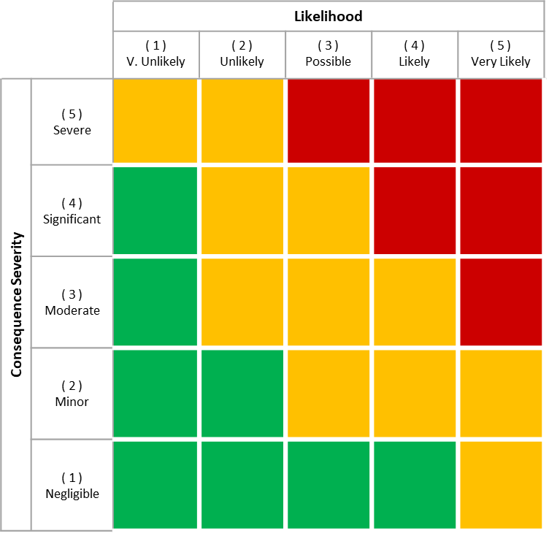
2. Model - Pre and Post Mitigated Risk
Pre-mitigation
When a work order created to report a defect in an item of equipment it is allocated 2 risk assessments.
Pre-mitigation: risk exposure prior to installing mitigating measures.
Post-mitigation: current risk exposure assuming that specific authorised mitigating actions have been implemented.
Post-mitigation
Example: the likelihood has been reduced due to a temporary repair.

Slide 10
2. Model - Risk Group
 |  | Likelihood
 |  | ( 1 ) V. Unlikely | ( 2 ) Unlikely | ( 3 ) Possible | ( 4 ) Likely | ( 5 ) Very Likely
Consequence Severity | ( 5 ) Severe | 5 | 10 | 15 | 20 | 25
 | ( 4 ) Significant | 4 | 8 | 12 | 16 | 20
 | ( 3 ) Moderate | 3 | 6 | 9 | 12 | 15
 | ( 2 ) Minor | 2 | 4 | 6 | 8 | 10
 | ( 1 ) Negligible | 1 | 2 | 3 | 4 | 5
Risk Rankings grouped into one of 3 Risk Groups.
High
Medium
Low
Each Likelihood / Consequence combination belongs to a risk group.
Each defect has a pre and post mitigation risk group.
High Risk
Medium Risk
Low Risk

Slide 11
2. Model - Overall Risk Status
Status | Definition | Rules
Red (#f42b03) | Critical - High risk of high business impact failure. | Defects exist with a post mitigation risk ranking in the high risk group
Orange (#d84a05) | Severe - Possibility of high severity business impact failure. | Defect exist in with a post mitigation consequence severity = 5
Yellow (#ec7505) | Substantial - Possibility of medium severity business impact failure. | Defect exist in the medium risk group.
Green (#5baf5a) | Low – Low risk of business impact failure. | Defect exist in the medium risk group.
Notes:
Explore color palettes - Coolors

Slide 12
2. Model - Overall Risk Status Calculation Breakdown
3. Create the rule relating a risk group to an overall risk status.
Overall risk status calculation
Red rule - Any defects in red area of risk matrix
Orange rule - Any defects with a severity 5
Yellow rule - >20 defects in the yellow area of the risk matrix
Green rule - <20 defects in the yellow area of the risk matrix
Risk matrix groupings
Red, Yellow, Green
2. Create the Risk Groupings based on the Risk Ranking
Risk Ranking number
1. Create a Risk Ranking Calculated Column

Slide 13
2. Model - Overall Risk Status Summary Text
Status | Text 1 – Number of defects | Formatting | Text 2 – Number scheduled in the next 7 days | Formatting | Text 3 – Number of defect current in backlog (overdue repair target date) | Formatting
Red - Critical | “There are # high risk defects at the site” | Red | “# of these defects are scheduled for repair in the next 7 days” | Red if < all are scheduled in the next 7 days. | “# of these defects are currently in backlog” | Red if >= # in backlog
Orange – Severe | “There are # high severity defects at the site” | Red | “# of these defects are schedule for repair in the next 7 days” | Red if < all are scheduled in the next 7 days. | “# of these defects are currently in backlog” | Red if >= # in backlog
Yellow – Substantial | “There are # medium risk defects at the site” | Red | “# of these defects are schedule for repair in the next 7 days” | Red if < all are scheduled in the next 7 days. | “# of these defects are currently in backlog” | Red if >= # in backlog
Green – Low | “There are # defects at the site” | None | “# of these defects are schedule for repair in the next 7 days” | None | “# of these defects are currently in backlog” | None

Slide 14
Pre / Post Mitigation Analysis
Risk Ranking | WO Count Pre | WO Count Post | Difference | Difference %
20 | 4 | 1 | -3 | -75%
16 | 1 | 0 | -1 | -100%
15 | 19 | 1 | -18 | -95%
…

Slide 15
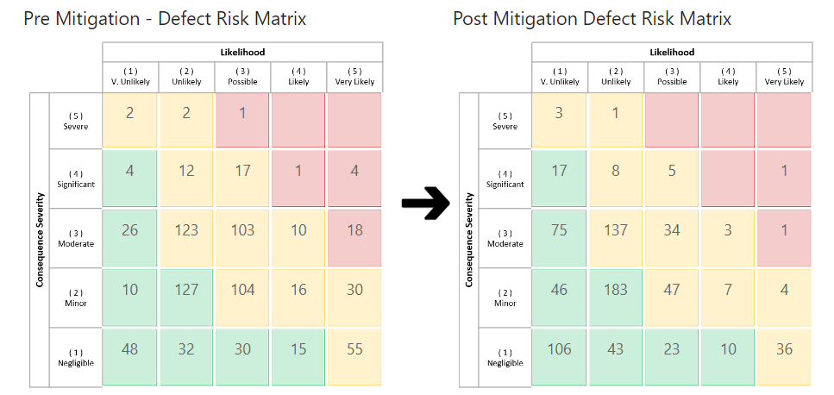
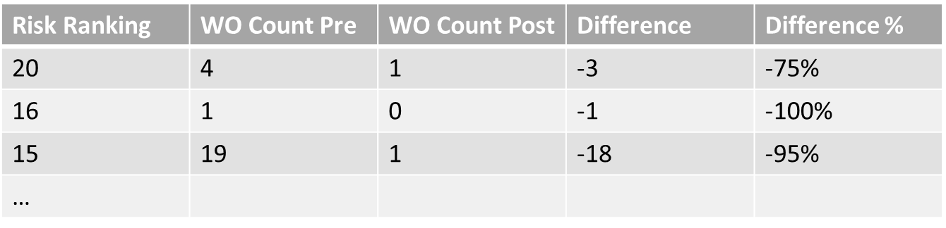
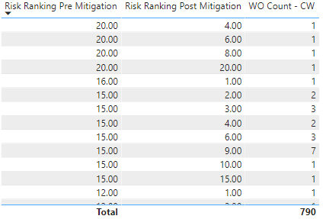
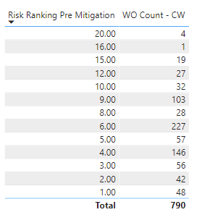
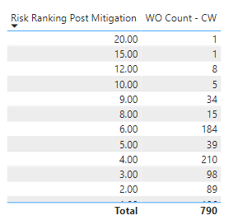
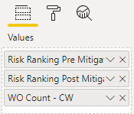
Why Use a Shared Risk Ranking Table?

Slide 16
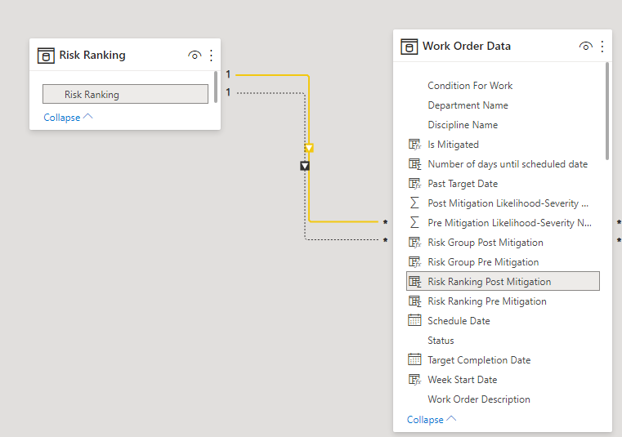
2. Model - Risk Ranking Relationships
Risk Ranking Active Relationship
There can only be one active relationship between two tables.
Risk Ranking -> Risk Ranking Post Mitigation is the always active relationship.
Risk Ranking -> Risk Ranking Pre Mitigation has a relationship BUT can be activated within a measure to utilise it.
Risk Ranking Inactive Relationship

Slide 17
2. Model - Performance Targets
The management has set the following performance targets.
1.) The number of high, medium and low risk defects should be trending downwards over the period.
2.) Work orders which are pasted their target finish or work orders for defects in the high risk group should be highlighted in any work order lists.
3.) The target for the total number of equipment defects is below 700.
This is split as follows: High = 0, Medium <=250, Low <=450

Slide 18
Defect Risk Trend Analysis - Requirements
Display a trend of the total number of defects over time.
Display a trend for each risk group.
For each trend show the first, last and highest number of defects over the period.
Create an automated narrative explaining the performance over the trended period and against the target.
Highlight deviations from the target values.

Slide 19
Date at the Start of the “Year Week” number
We have a “Year Week” number in the data model.
This is a time stamp assigned to all the work orders that were open at the start of that year and week number.
When trending we need to work with actual dates.
The following code is use to find the start date of the year week numbers given a year and a week number.
WeekStartDate = DATE(YearNumber,1,1)-WEEKDAY(DATE(YearNumber,1,1),2)+(Weeknumber-1)*7+1

Slide 20
Calculating [Week Start Date]
Step 3a
Step 3b
Value in table = 202024 (Year 2020, Week 24) -
What is the start date of this week?
Find the number of days up to the previous week for the week number. E.g. 24-1 = 23.
…and then multiple that previous week number by 7 to get the number of days in that number of weeks.
E.g. (24-1)*7 = 161
WeekStartDate = DATE(YearNumber,1,1)-WEEKDAY(DATE(YearNumber,1,1),2)+(Weeknumber-1)*7+1
-1
201952
202001
202023
202024
M
T
W
T
F
S
S
M
T
W
T
F
S
S
M
T
W
T
F
S
S
M
T
W
T
F
S
S
23
24
25
26
27
28
29
30
31
1
2
3
4
5
1
2
3
4
5
6
7
8
9
10
11
12
13
14
Step 2
Step 1
+161 days
Step 3c
Wed 3rd day of the week (starting Monday).
So minus 3 days from start of year takes us to the end of the previous week of the year.
Start on the first day of the year. The date is 2020/1/1
Step 4
Add step 3b number of days (161) to the date determined in step 2 29/12/2019. This will take us up to the end of week 23.
Finally add 1 to get the date at the start of week 24 = 08/06/2020
We now know were to start counting from

Slide 21
Appendix A: Risk Matrix Image
 |  | Likelihood
 |  | ( 1 ) V. Unlikely | ( 2 ) Unlikely | ( 3 ) Possible | ( 4 ) Likely | ( 5 ) Very Likely
Consequence Severity | ( 5 ) Severe
 | ( 4 ) Significant
 | ( 3 ) Moderate
 | ( 2 ) Minor
 | ( 1 ) Negligible

Slide 22
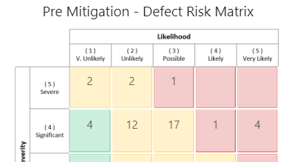
Appendix B: Colours for Risk Rank and Risk Group Formatting
Green - #CCEFDC
Red - #F5CCCC
Yellow - #FFF2CC

